Slide 1
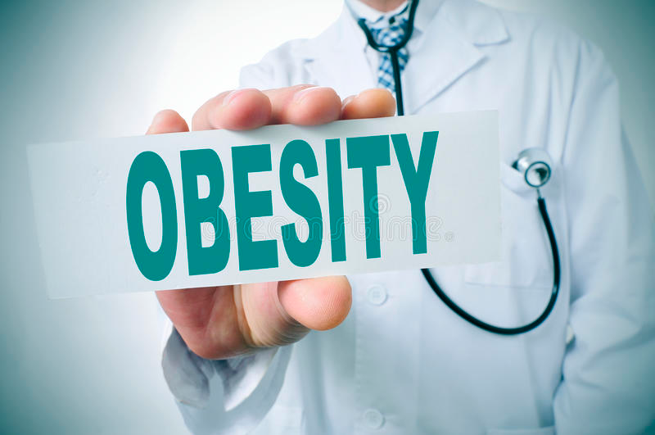
OBESITY
Name:
Tutor:

Slide 2
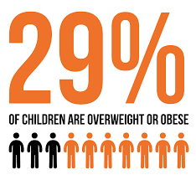
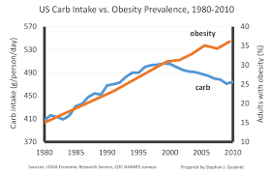
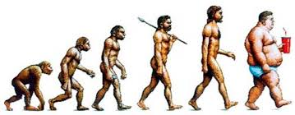
Introduction
Obesity is a condition in which the excess body fat has surrounded most visceral organ in such that it has negative impact on the individual health
Currently Obesity the rate of killing has been on the rise
Statistics of obesity in America
The prevalence of obesity was 39.8% and affected about 93.3 million of U.S. adults in 2015-2016
The Hispanics leads in prevalence rate at 47% followed by the non-Hispanic blacks at 46.8% non-Hispanic whites 37.9% and Asians 12.7%
The prevalence of obesity was 29% among young adults age between 20–39 years, 42.8% among middle-aged adults age 40-59 years, and 41.0% among older adults age 60 and over
Notes:
Hello everyone, my today’s presentation is centered on one major healthy problem affecting almost everyone in the society today-obesity. I will begin by defining the manace. Obesity is defined as condition in which the excess body fat forms in most visceral organ in such away that it could negatively impact on the individual health.
The rate of obesity has been increasing in the United states of America for the past three decades.
The prevalence of obesity was 39.8% and affected about 93.3 million of U.S. adults in 2015-2016.With these prevalence its means that a third of individuals in the USA are Obese.
The Hispanics leads in prevalence rate at 47% followed by the non-Hispanic blacks at 46.8% non-Hispanic whites 37.9% and Asians 12.7%.The prevalence of obesity was 35.7% among young adults age 20–39 years, 42.8% among middle-aged adults age 40-59 years, and 41.0% among older adults age 60 and over

Slide 3
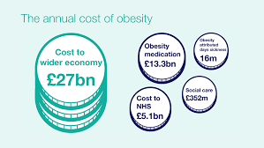
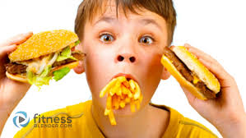
Obesity and socioeconomics in the USA
Lower preference of obesity is recorded among the men and women with college degree in the United States of America
The same obesity and education pattern was seen among non-Hispanic white, non-Hispanic black, and Hispanic women, and also among non-Hispanic white men, although the differences were not all statistically significant
The obesity prevalence increased with education attainment among the non-Hispanic black male with education attainment
Notes:
There is a much lower prevalence of obesity that many studies have indicated among the men and women with college degree. The same obesity and education pattern was seen among non-Hispanic white, non-Hispanic black, and Hispanic women, and also among non-Hispanic white men, although the differences were not all statistically significant. The obesity prevalence increased with education attainment among the non-Hispanic black male with education attainment. Among non-Hispanic Asian women and men and Hispanic men there were no differences in obesity prevalence by education level.

Slide 4
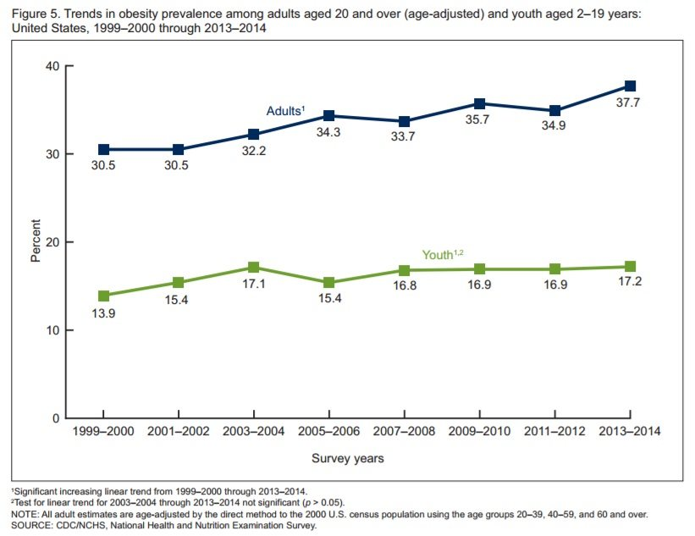
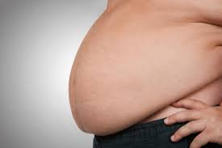
Prevalence among Men
Among men, obesity prevalence was lower in the lowest and highest income groups compared with the middle income group were there is obesity prevalence
This pattern was seen among non-Hispanic white and Hispanic men
Obesity prevalence was higher in the highest income group than in the lowest income group among non-Hispanic black men
Notes:
Among men the obesity was lower among the lowest income groups compared with the middle and the lower in income groups. The above pattern in repeated among the non-Hispanic white and the non Hispanic men. However among the non-Hispanic colored men the obesity prevalence was higher in the highest income groups and lowest in the lowest income groups among the non-Hispanic black men

Slide 5

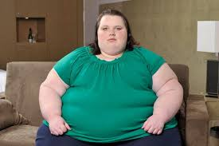
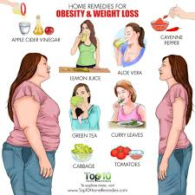
Prevalence Among women
Among the women the highest prevalence was found among the women with the lower and middle income and lower in women with highest income
The prevalence of pattern with income was observed among Hispanic women, non-Hispanic white and Hispanic
In reference to non-Hispanic women, there was no significance variation with income
Notes:
Among the women the highest prevalence was found among the women with the lower and middle income and lower in women with highest in come. The prevalence of pattern with income was observed among Hispanic women, non-Hispanic white and Hispanic. In reference to non-Hispanic women, there was no significance variation with income

Slide 6
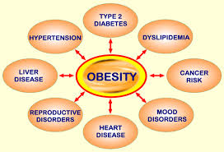
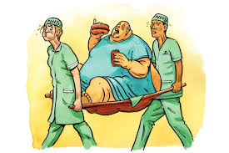
Risk factors
Insulin resistance may occur due to obesity leading to diabetes type 2
There is increase level of type 2 diabetes among the individual who are obese compared to other individuals
Another risk that associated with obesity in the high blood pressure which h has been found to be common among the individuals suffering from obesity
There are studies that have found that the risk of heart attack is very high among the individuals suffering from obesity
Other risk factors that are associated with obesity include the gall stones, Gout, osteoarthritis and sleep apnea
Notes:
Insulin resistance may occur due to obesity leading to diabetes type 2.Another risk level is increased level of type 2 diabetes among the individual who are obese compared to other individuals. High blood pressure which has been found to be common among the individuals suffering from obesity is another risk factor. There are studies that have found that the risk of heart attack is very high among the individuals suffering from obesity. Other risk factors that are associated with obesity include the gall stones, Gout, osteoarthritis and sleep apnea

Slide 7
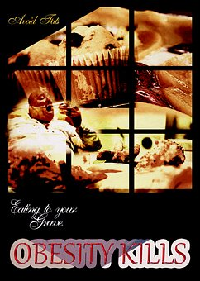
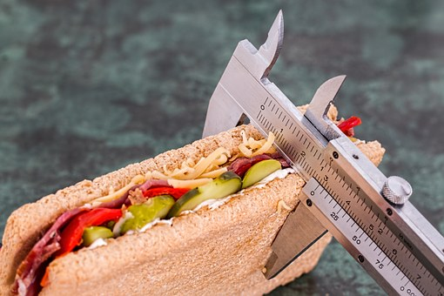
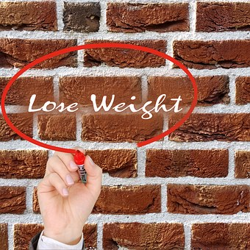
Conclusion
obesity is a community health challenge which affects many people
This disease is a common community health problem in the United States considering that about a third of the people are Obese
Insulin resistance might arise because of obesity resulting in diabetes type 2
obesity increases one’s risk of suffering from heart attack, sleep apnea, gallstones, osteoarthritis, as well as gout
education is the recommended as an ideal measure for countering obesity
Notes:
To sum up, obesity is a community health challenge which affects many people. In that, obesity refers to a state whereby the excess fat in one’s body develops in the instinctual organ and adversely affects one’s health. This disease is a common community health problem in the United States considering that about a third of the people are Obese. As a matter of fact, obesity increases one’s risk of suffering from heart attack, sleep apnea, gallstones, osteoarthritis, as well as gout. Education is the recommended as an ideal measure for countering obesity.

Slide 8
Sources
https://www.google.com/search?q=images+of+obesity&client=firefox-b-ab&tbm=isch&tbo=u&source=univ&sa=X&ved=0ahUKEwiquvCVkPPbAhWsAsAKHSB6DDQQsAQIJg&biw=1366&bih=654#imgrc=SopFKfPwuEBFEM
https://www.spectator.co.uk/2013/10/the-battle-of-the-bulge/
http://foothillsfamilycarellc.com/psfh/diseases/obesity/
https://www.google.com/search?q=images+of+obesity&client=firefox-b-ab&tbm=isch&tbo=u&source=univ&sa=X&ved=0ahUKEwiquvCVkPPbAhWsAsAKHSB6DDQQsAQIJg&biw=1366&bih=654#imgrc=VPkIzbgeSX-sVM:
https://www.google.com/search?q=images+of+obesity&client=firefox-b-ab&tbm=isch&tbo=u&source=univ&sa=X&ved=0ahUKEwiquvCVkPPbAhWsAsAKHSB6DDQQsAQIJg&biw=1366&bih=654#imgrc=w6w9QrNWcMA8eM:
http://edafeo.com/site/2016/04/13/is-obesity-self-inflicted/
ttps://www.foodnavigator.com/Article/2018/01/16/Scots-face-reality-of-obesity-s-effects-as-survey-backs-firm-action
https://www.mirror.co.uk/news/uk-news/child-obesity-timebomb-warning-parents-2971931
http://www.obesityactionscotland.org/
http://wholehealthsource.blogspot.com/2015/11/carbohydrate-sugar-and-obesity-in.html
https://sciencebasedmedicine.org/bmi-and-the-obesity-epidemic/

